Slide 1

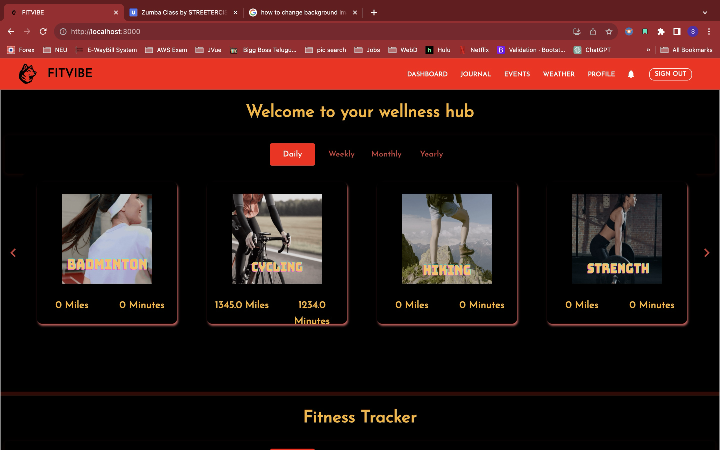

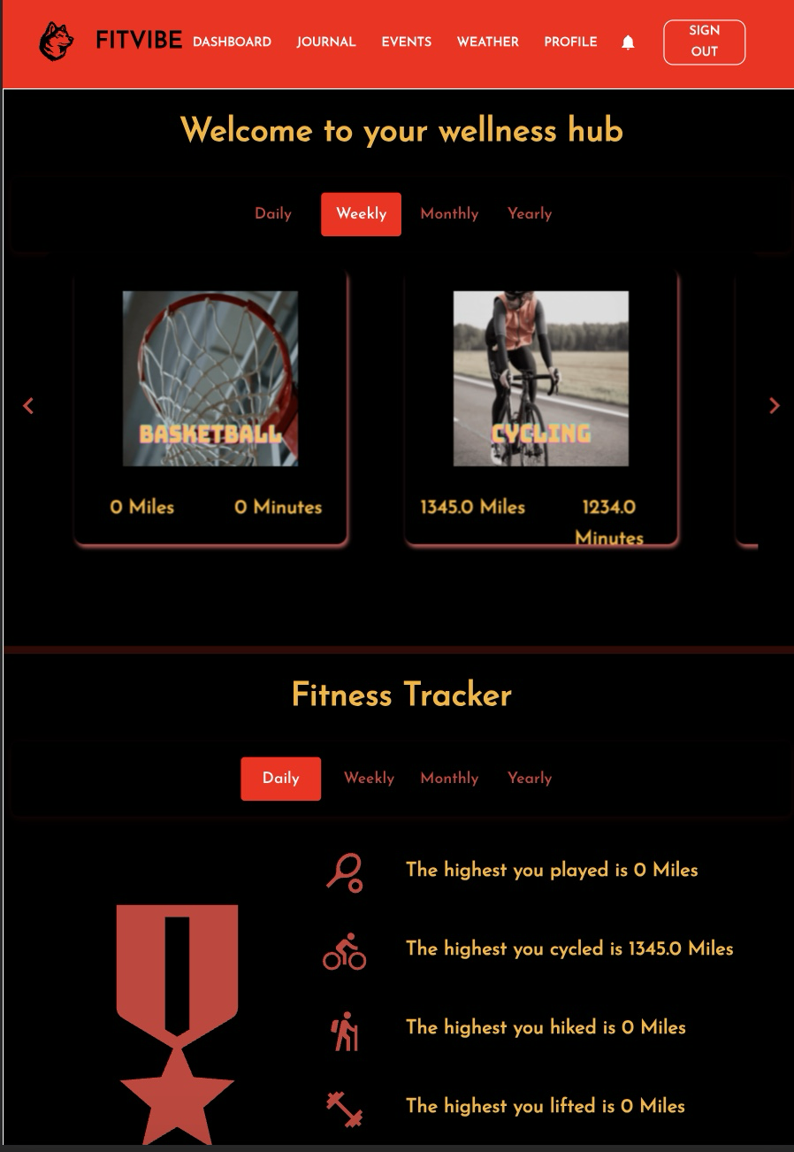
FITVIBE
A Fitness tracking website
FitVibe is a comprehensive tool that enables students to monitor their daily routines, such as eating, exercising, sleeping, and studying. With a responsive UI powered by ReactJS, it utilizes a scalable NodeJS server with ExpressJS middleware to manage requests.
Notes:
f

Slide 2





Team 16
Mukhesh
Renuka
Srivarini
Saatwika
Sreshta

Slide 3
Tech Stack
HTML
CSS
Bootstrap
JavaScript
Express
Node
React
MongoDB

Slide 4
Services
Open Weather API
Ticket Master API
Google
E—mail
Service

Slide 5
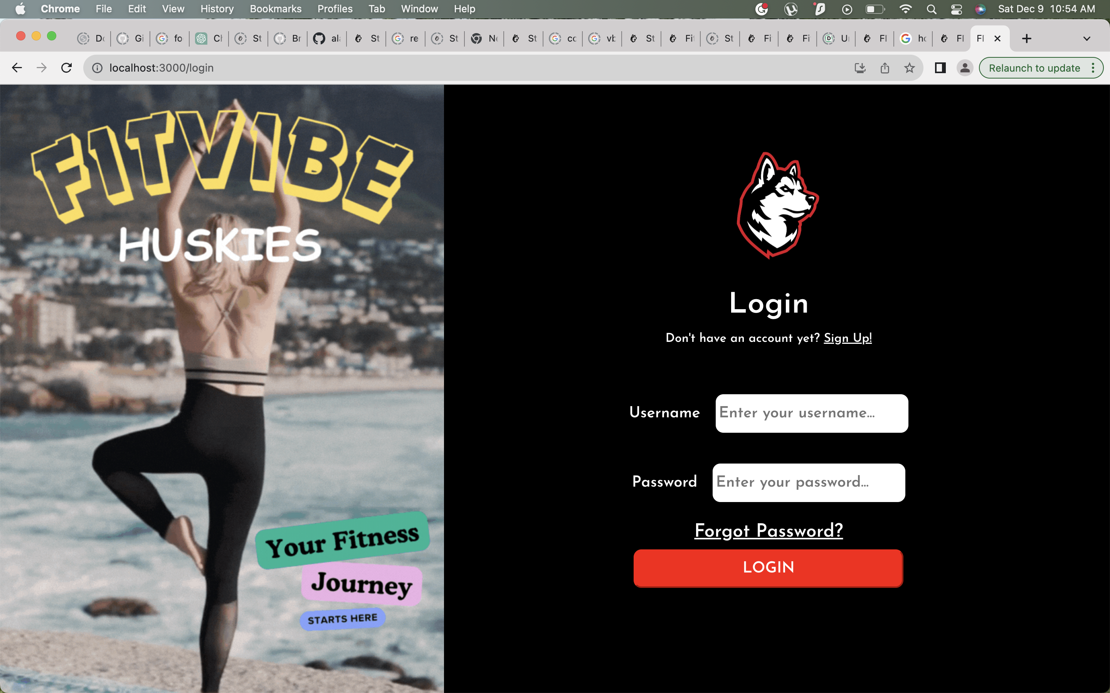
Log In Page

Slide 6
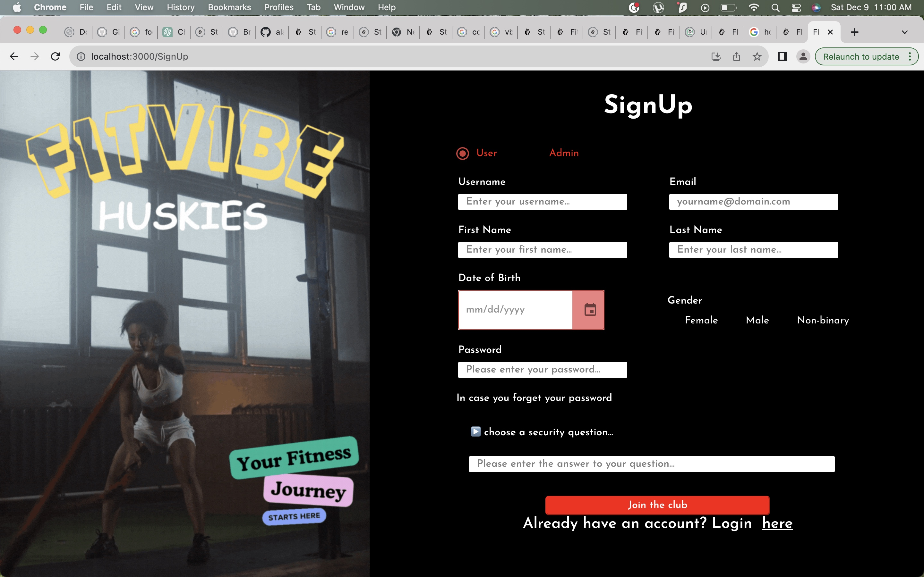
Sign up Page

Slide 7
User Dashboard

Slide 8
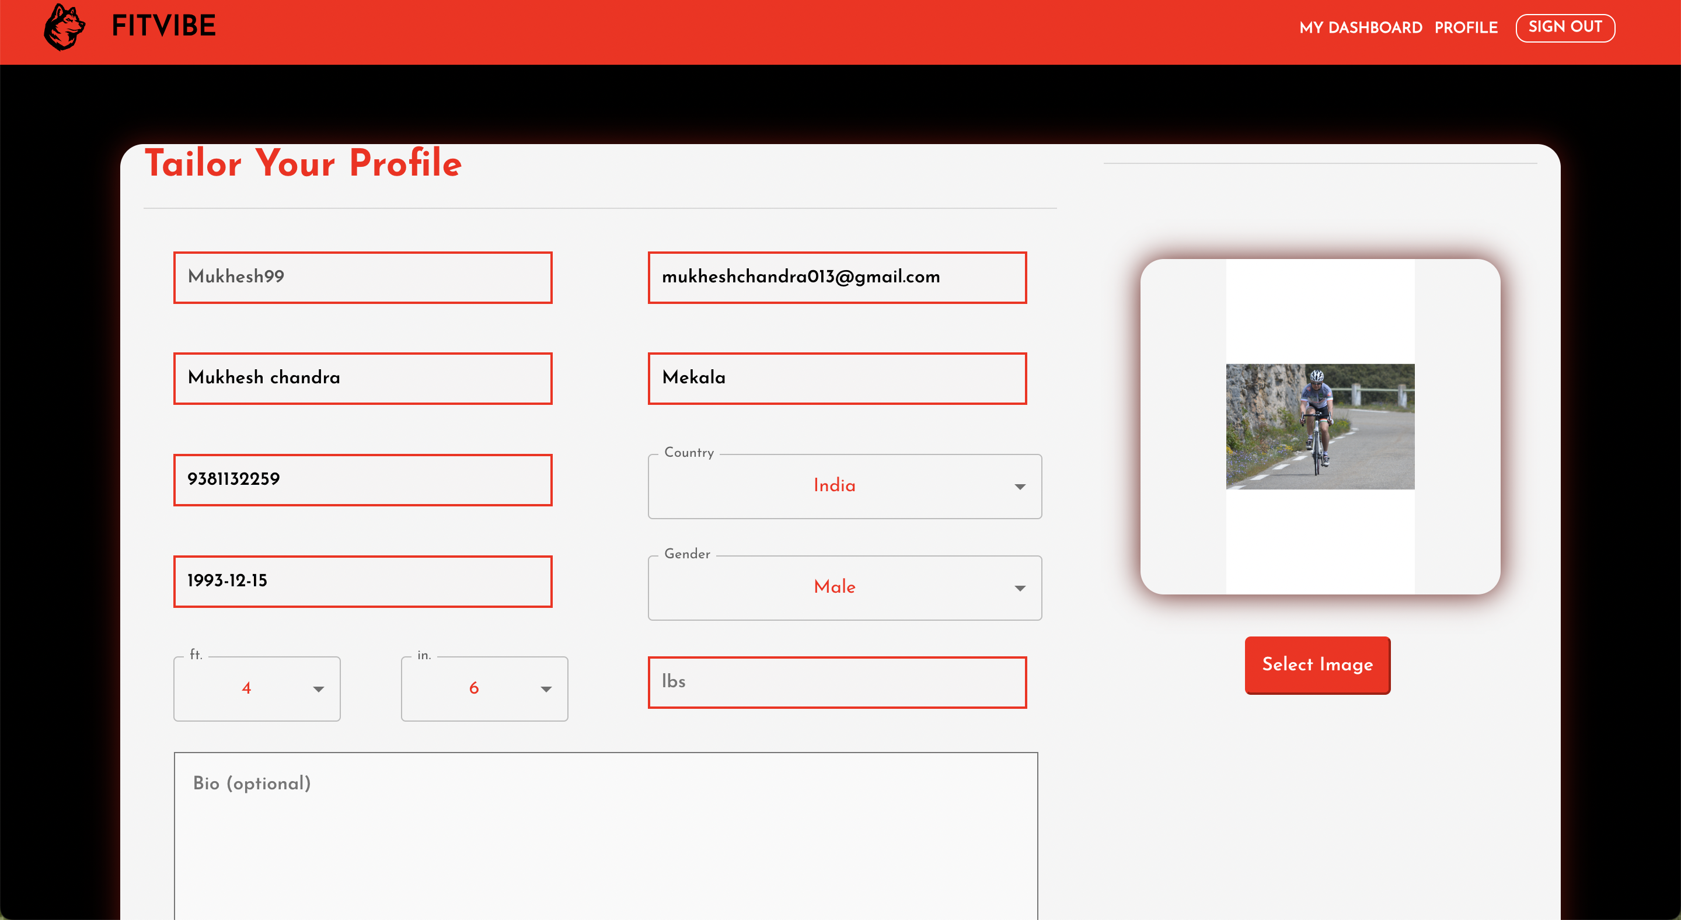
User Profile

Slide 9
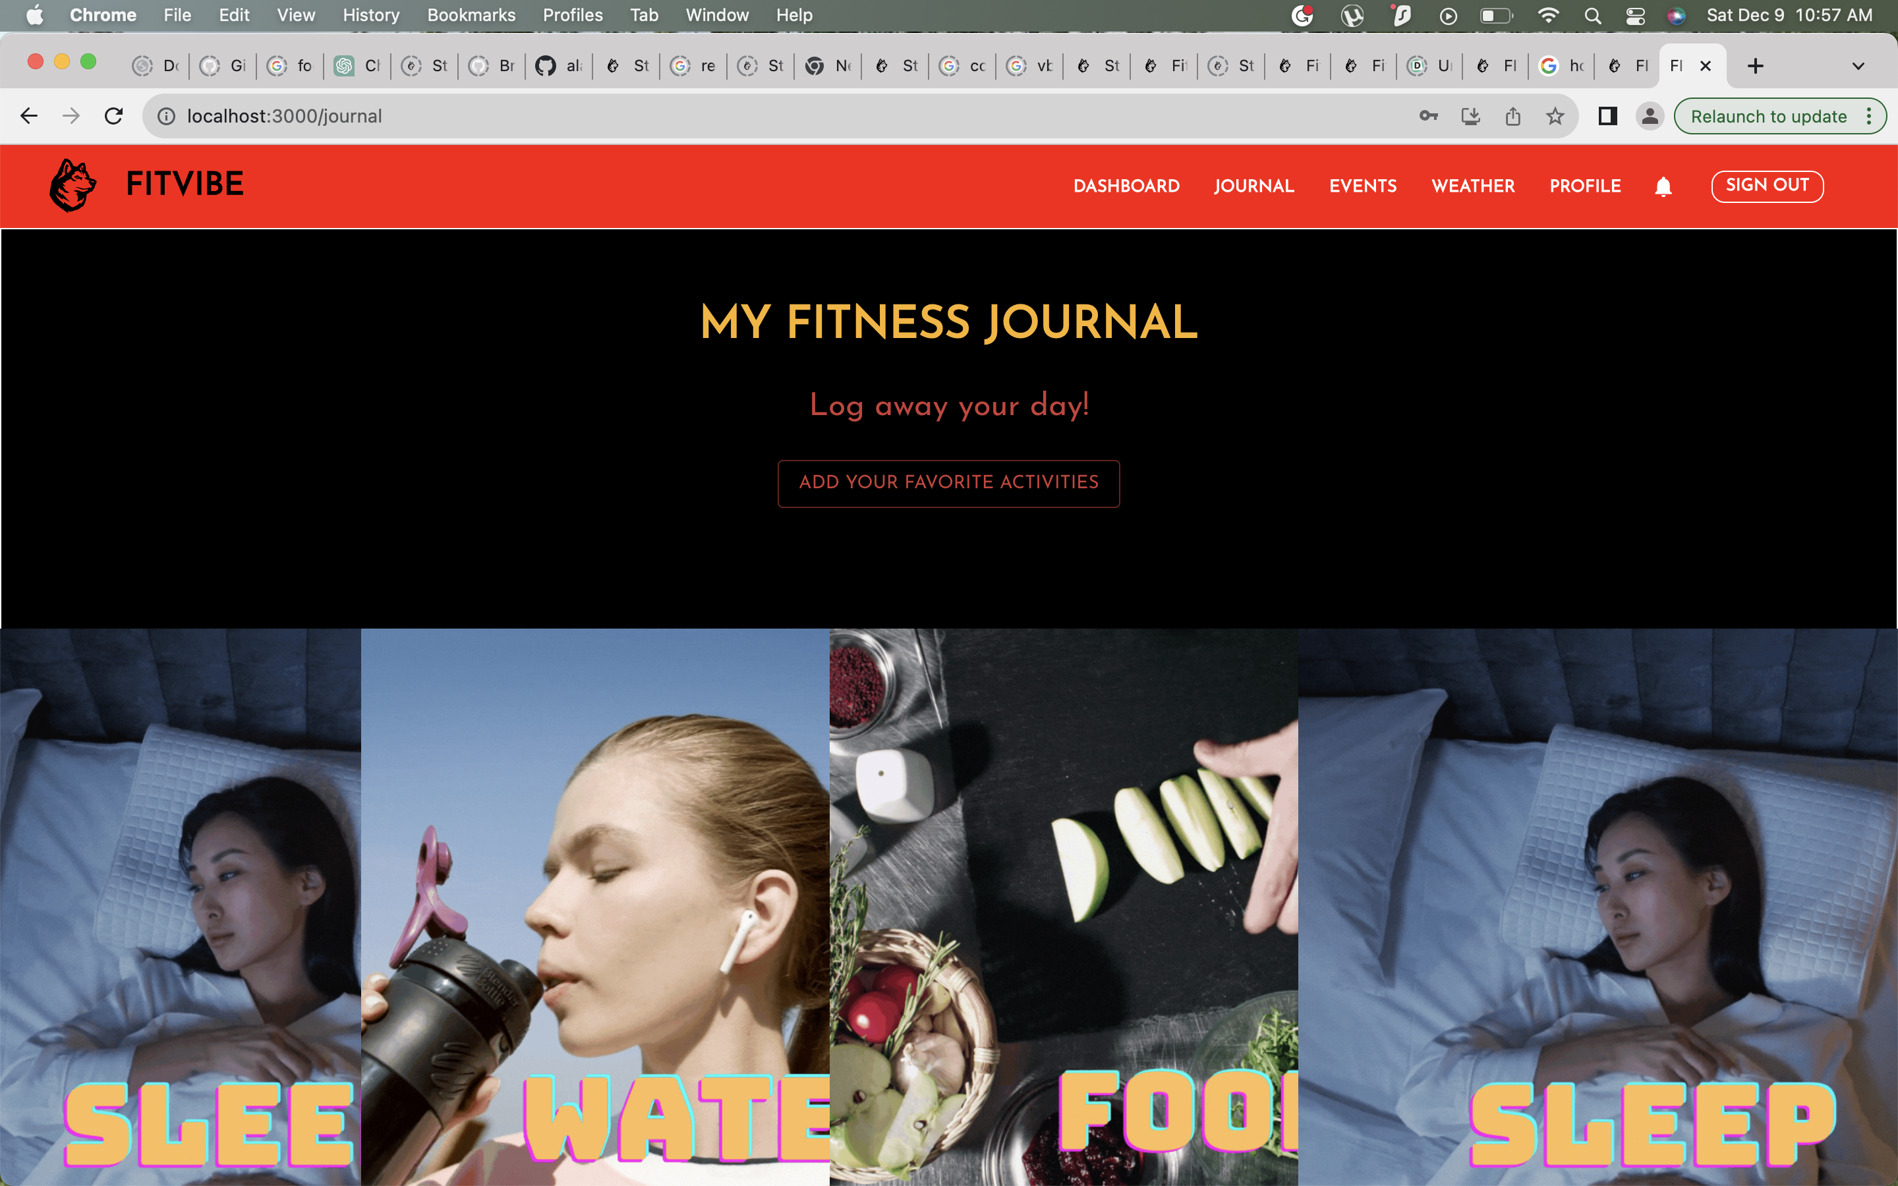
Fitness Journal

Slide 10
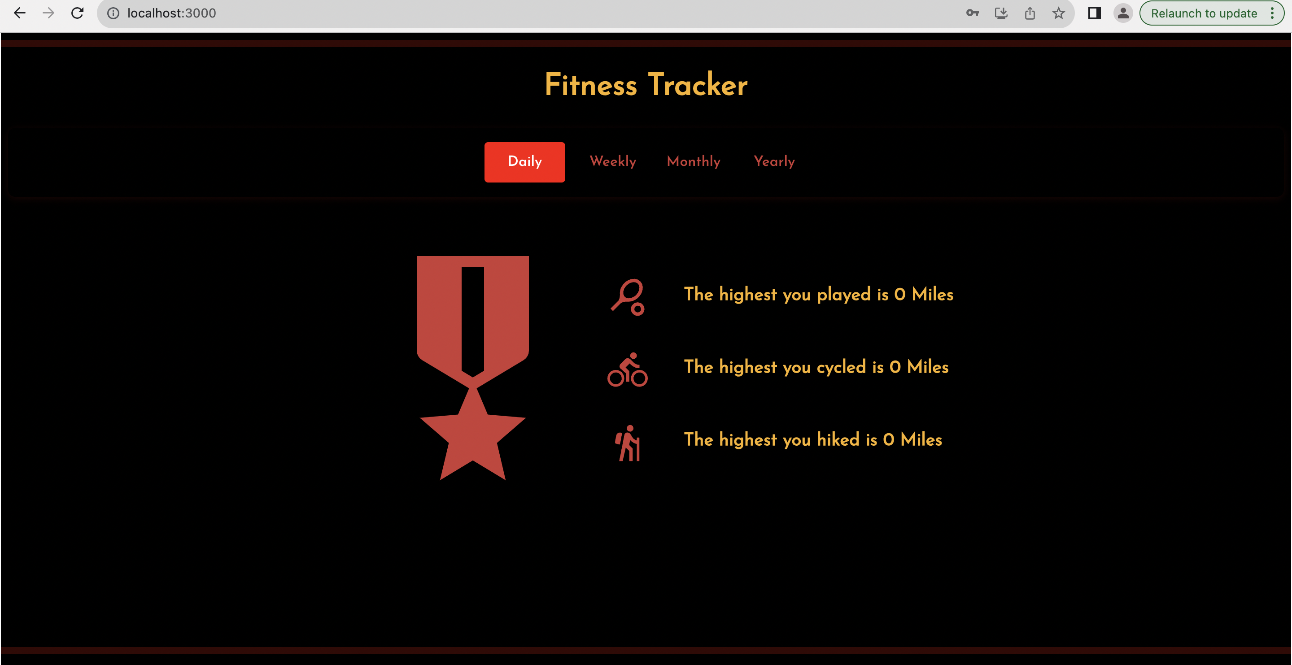
Personalized Fitness Tracker

Slide 11
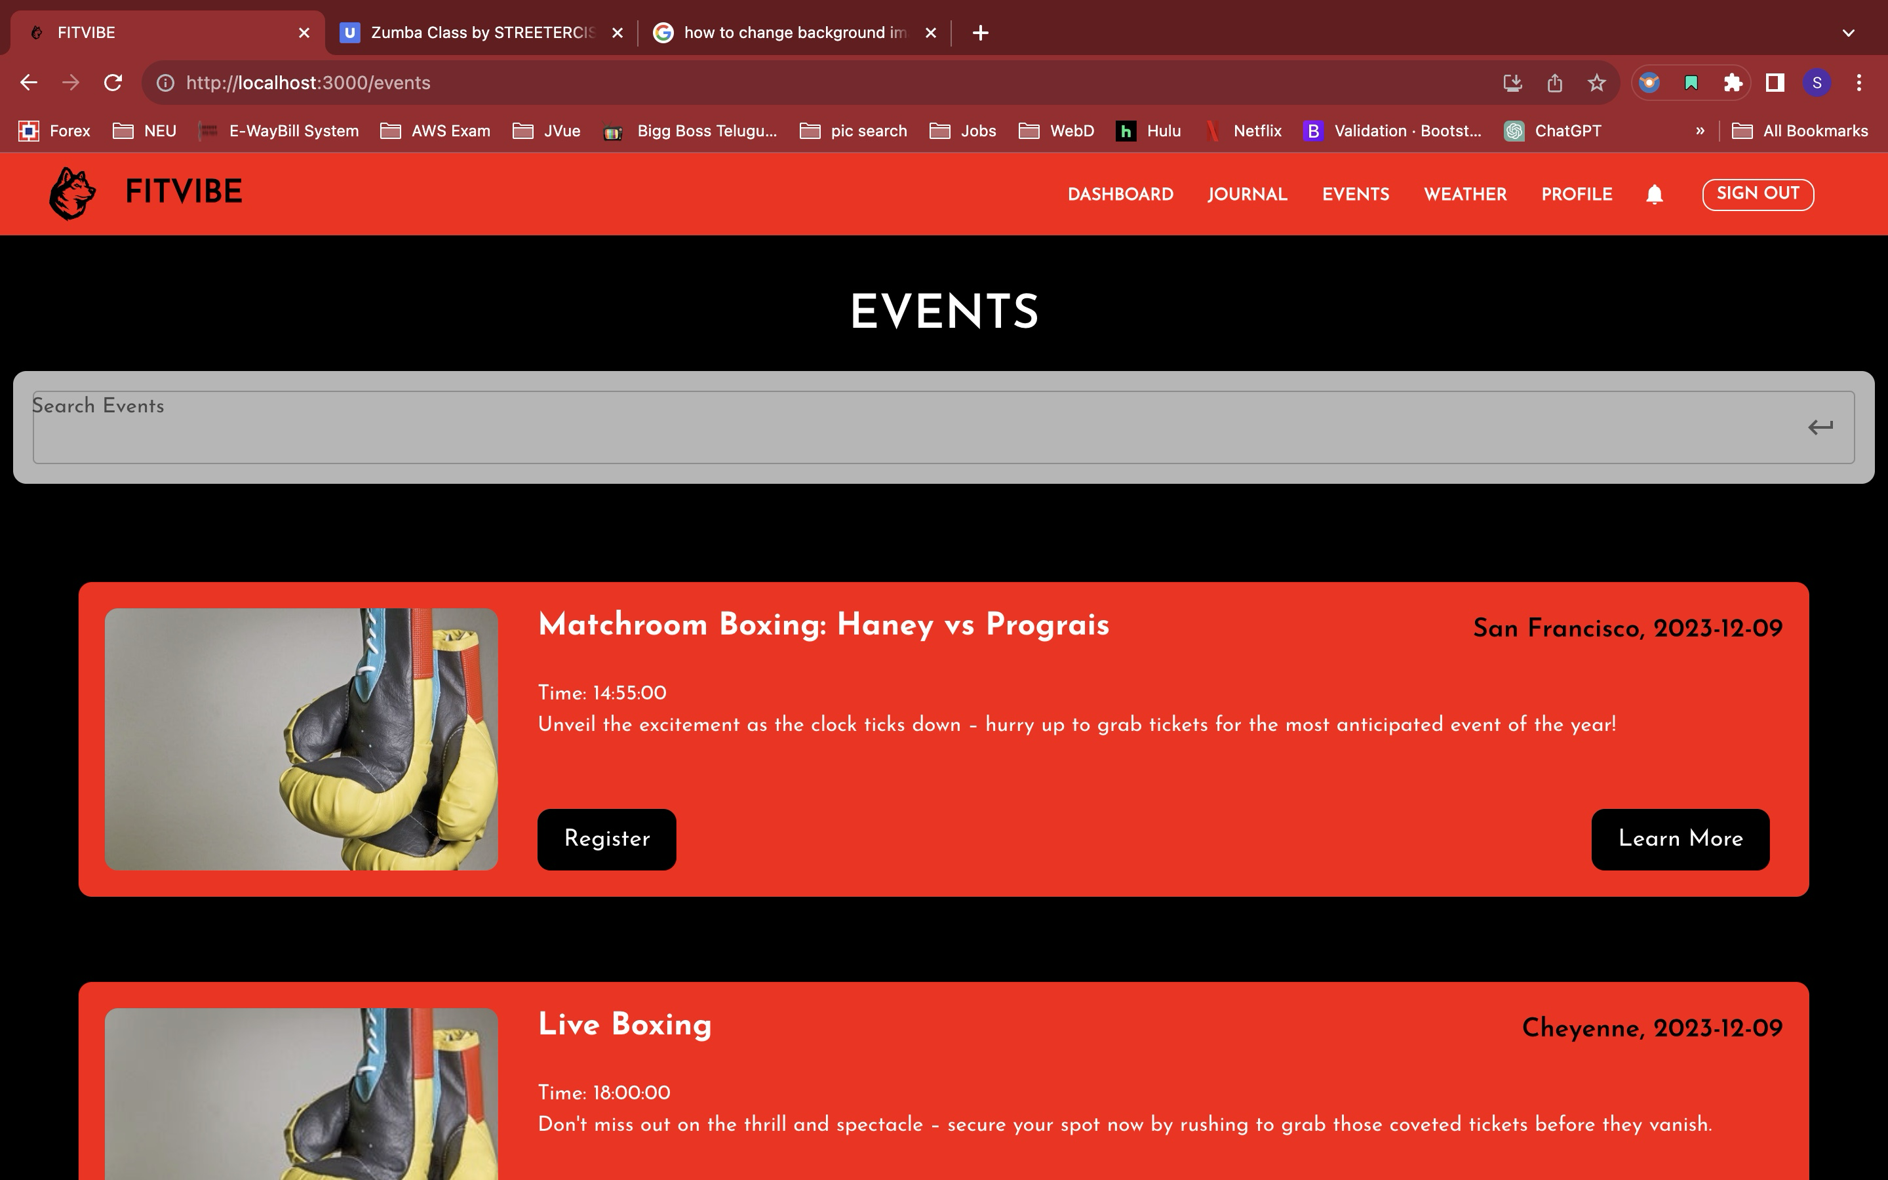
View Events(Users)

Slide 12
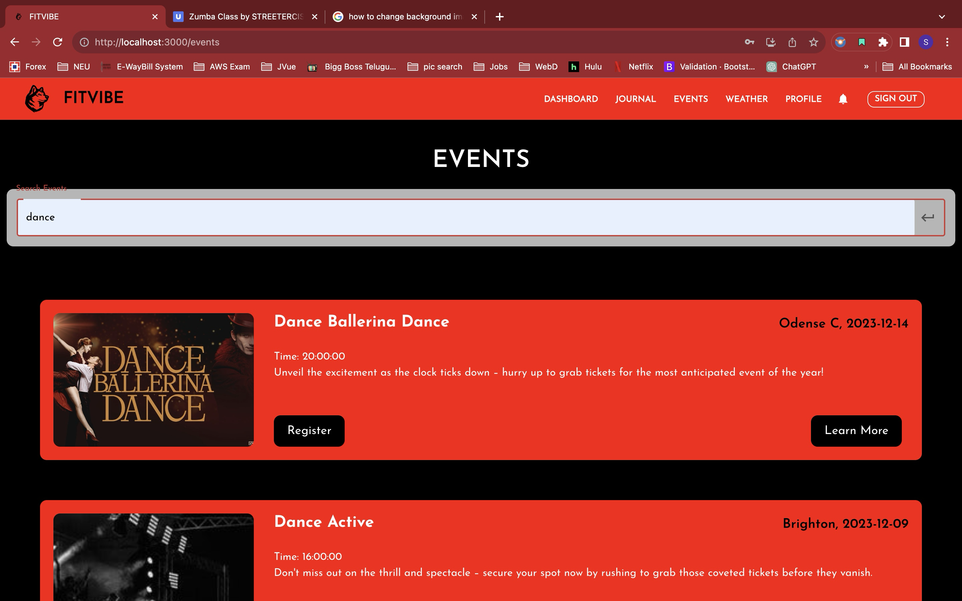
Search Events(Users)

Slide 13
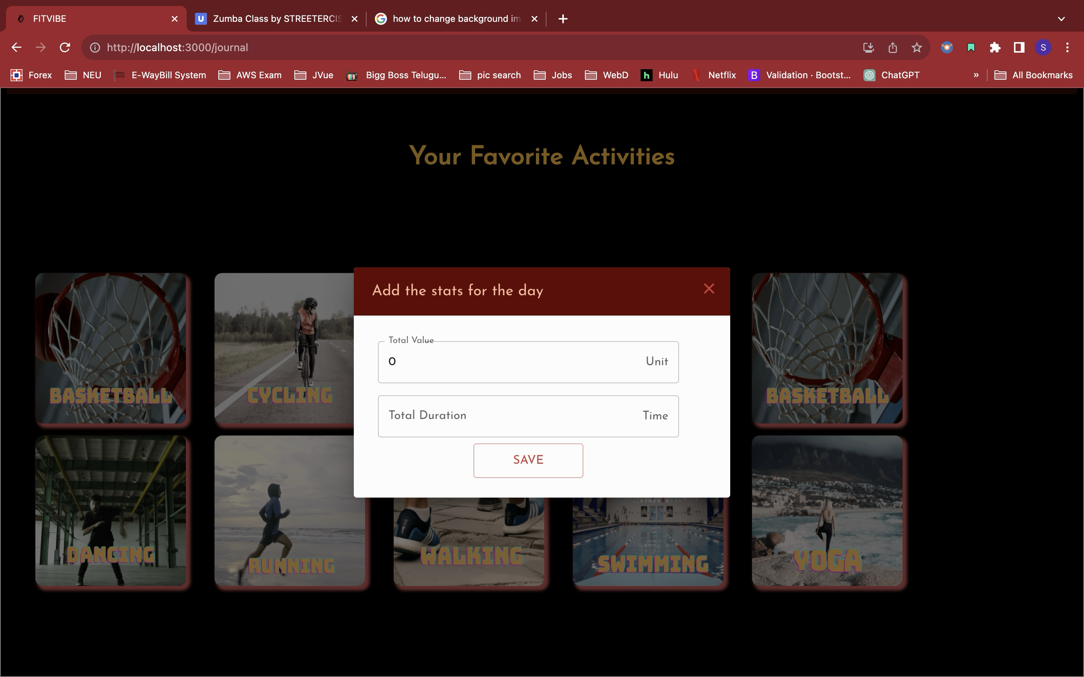
Track your Activity

Slide 14
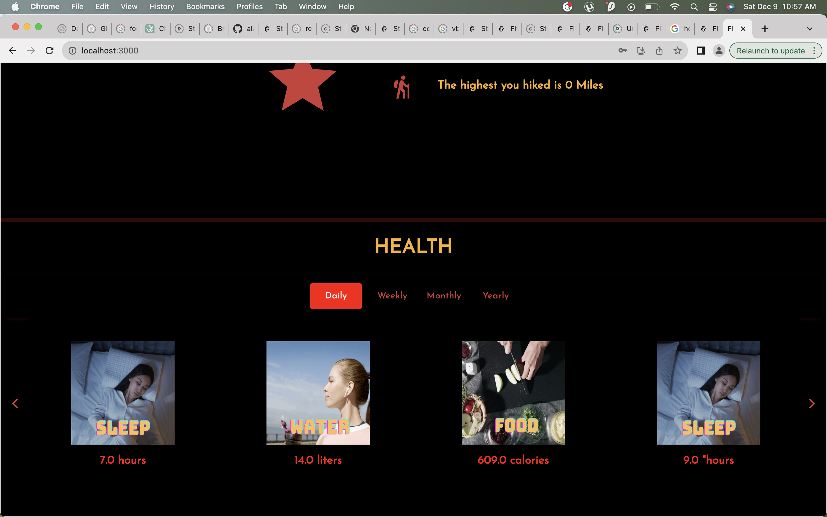
Health Tracker

Slide 15
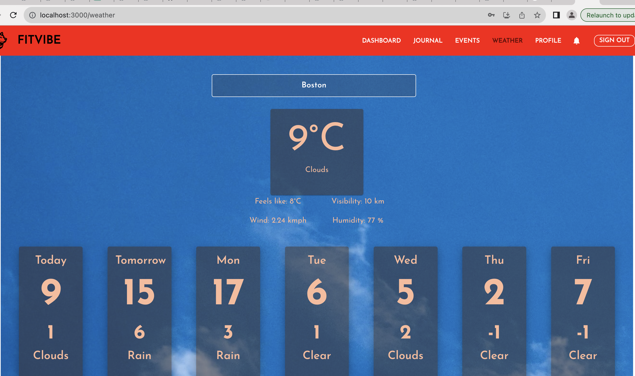
Weather Tracker
001560891

Slide 16
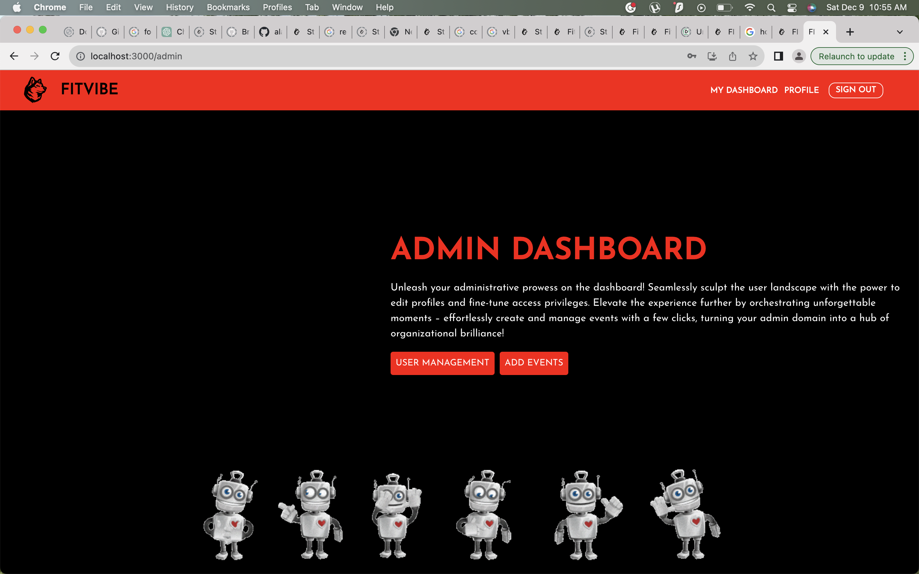
Admin Dashboard

Slide 17
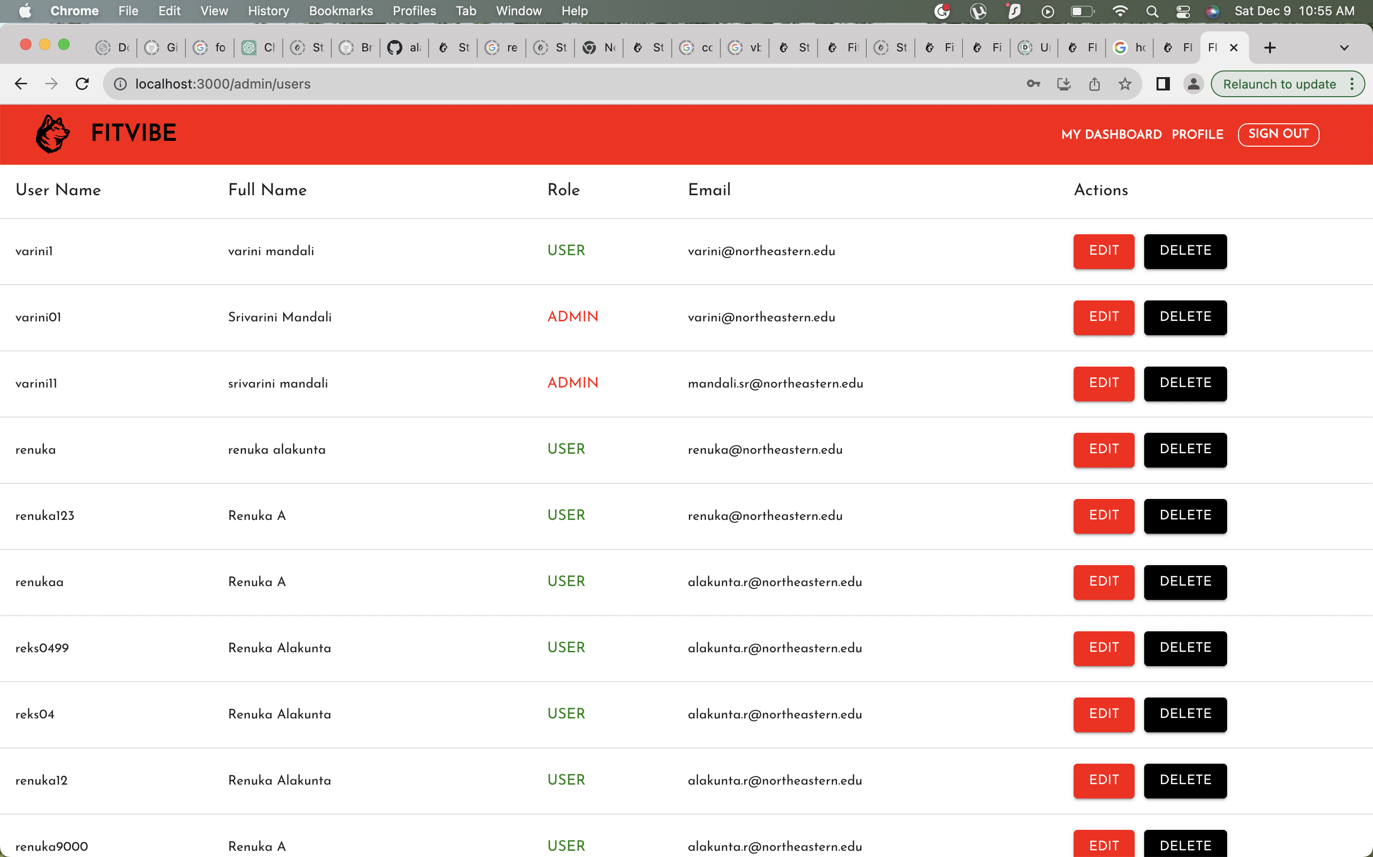
Manage Users (ADMIN)

Slide 18
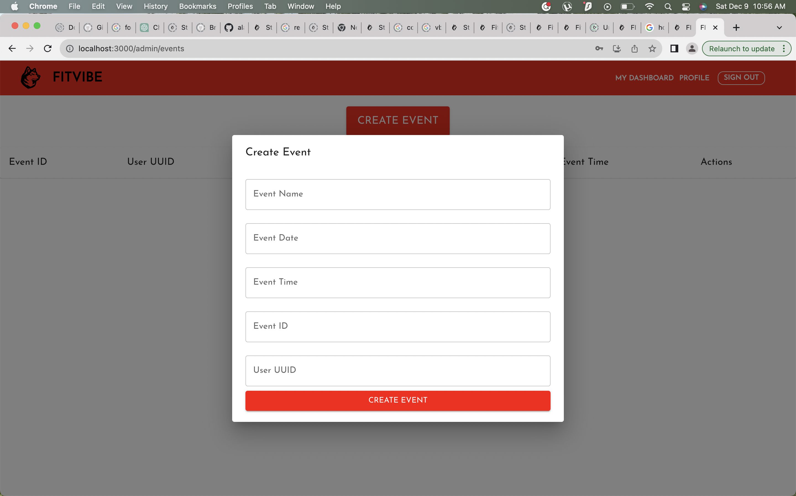
Create Event (Admin)

Slide 19
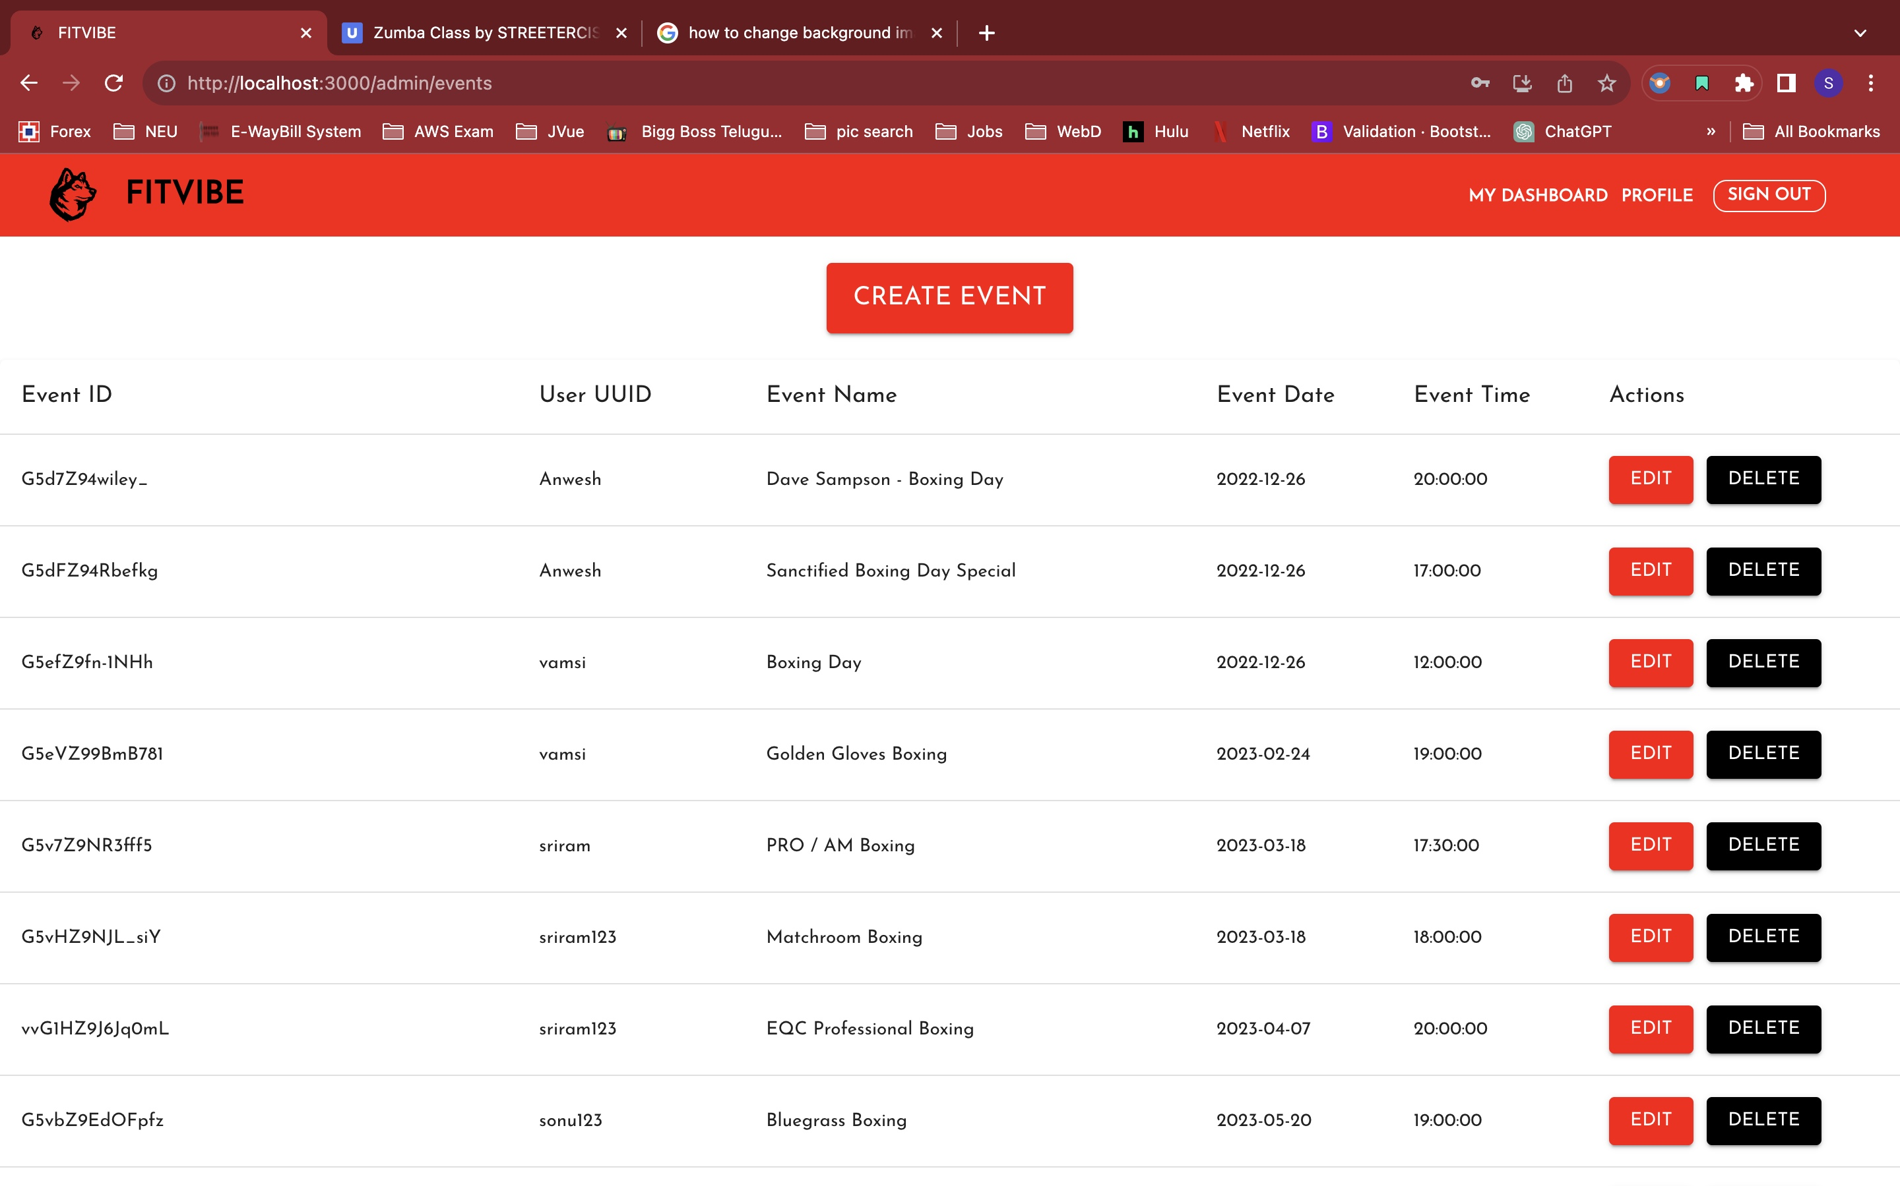
View Event (Admin)

Slide 20
THANK YOU

